Slide 1
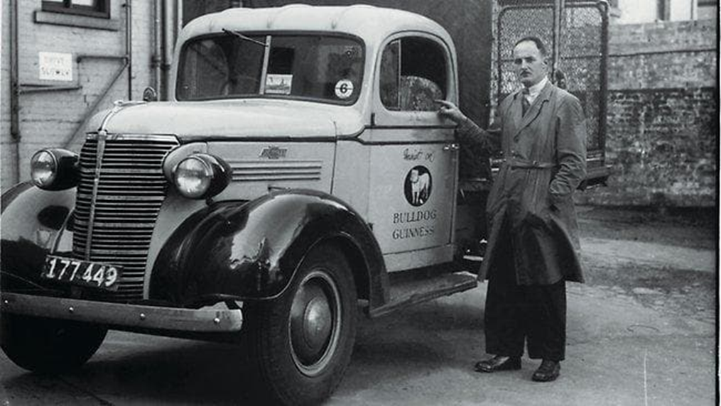
Forecasting Utilization Rates
Source: Victoria Police
Victoria Police Forensic Services Centre
by Sherri McRae Supervisor: Chris Bell, Intelligence & IT Group Manager

Slide 2
Contents
Methodology and Data Overview
Complex Models
Flat Forecasts
Results
Conclusions

Slide 3
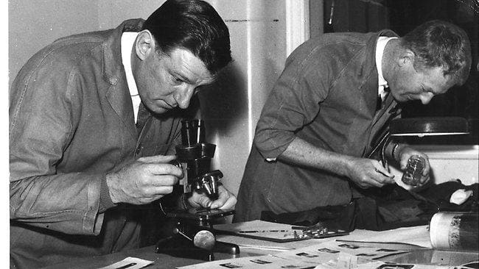

Which models produce the best forecasts for utilization rates?

Slide 4
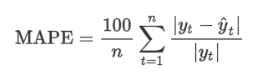
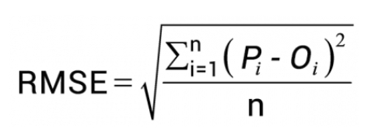
Methodology and Data Overview
Utilization rate = number of cases forensics
number of cases Victoria
Times series data: monthly from July 2005 to April 2019
Proc ARIMA vs. Proc ESM
10 observations held out for forecast validation
Quality metrics: RMSE, MAPE, AIC, BIC, residual analysis

Slide 5
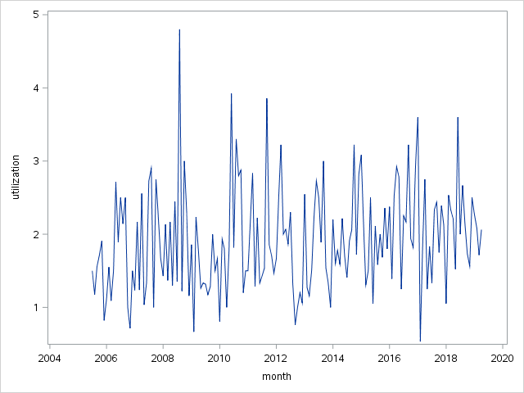
Homicide

Slide 6
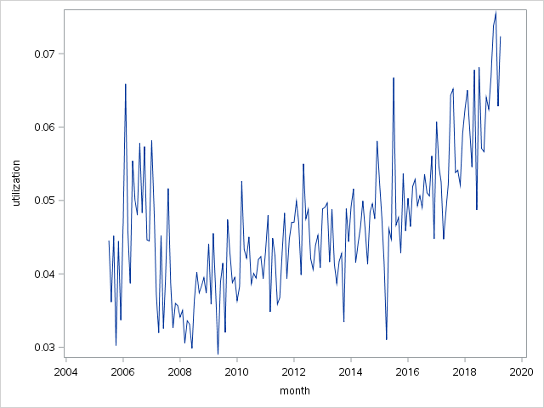
Burglary (Residential)

Slide 7
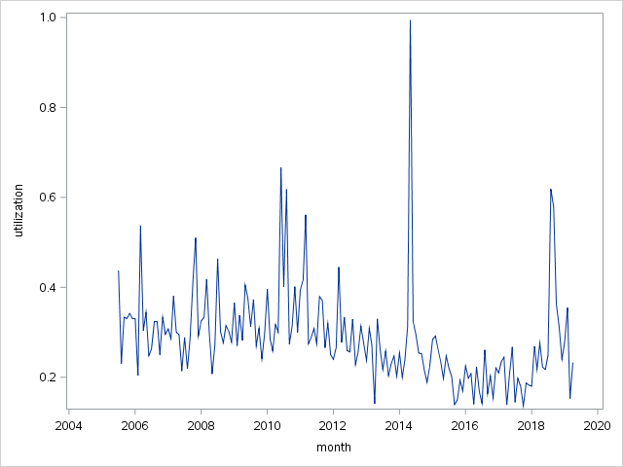
Rape

Slide 8
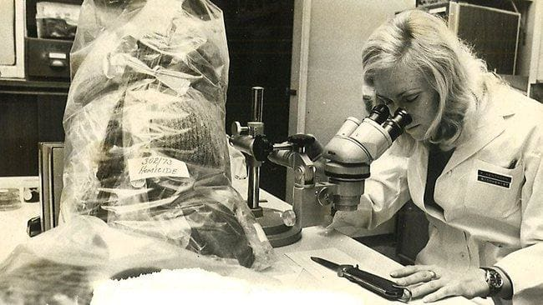
Complex Models
Source: Archive News Ltd.

Slide 9
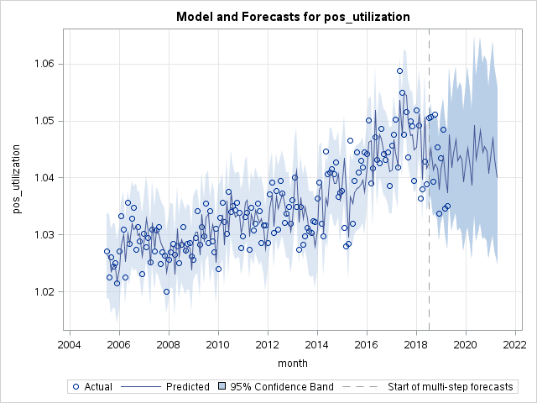
ESM Forecast for Overall Utilization
Model: Winters [log(x + 1) transform]

Slide 10
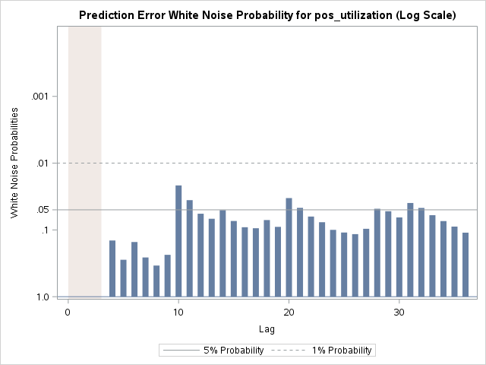
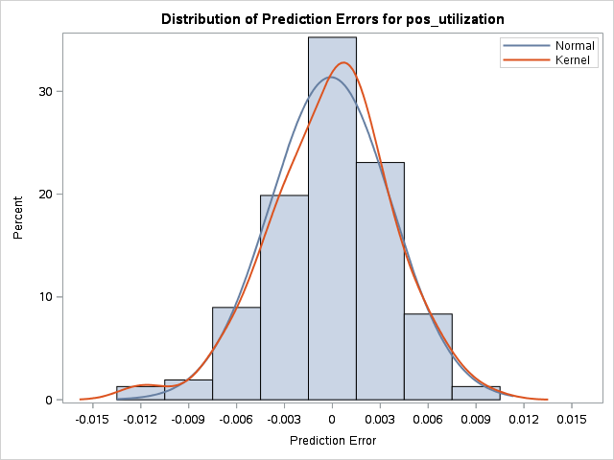
ESM Model Residuals Overall Utilization

Slide 11
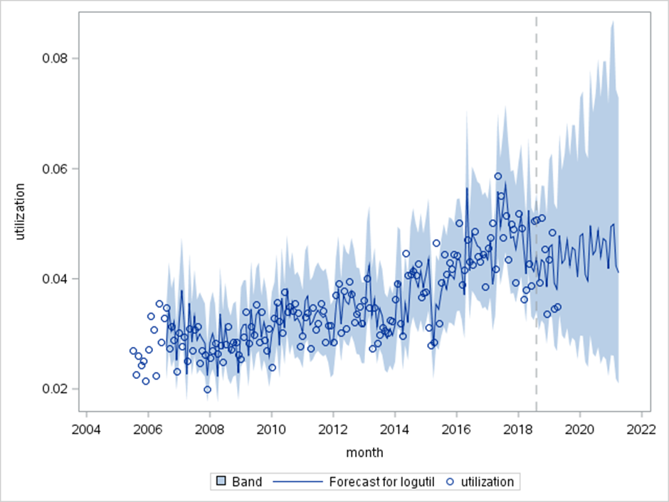
SARIMA Forecast for Overall Utilization (1)
Model: SARIMA(3,1,1)x(0,1,1)₁₂ [log transform]

Slide 12
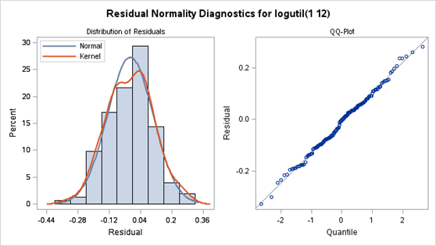
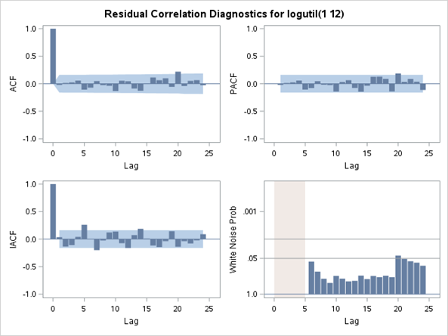
SARIMA Model Residuals Overall Utilization (1)

Slide 13
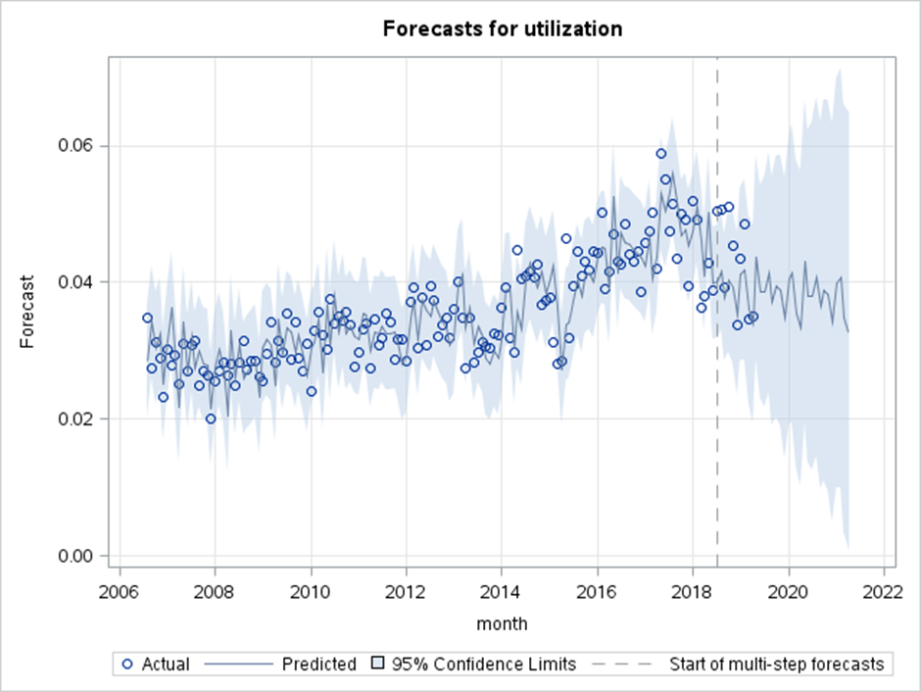
SARIMA Forecast for Overall Utilization (2)
Model: SARIMA(2,1,0)x(0,1,1)₁₂
Model: Winters [log(x + 1) transform]

Slide 14
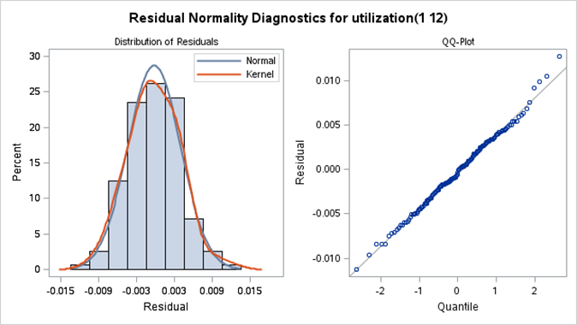
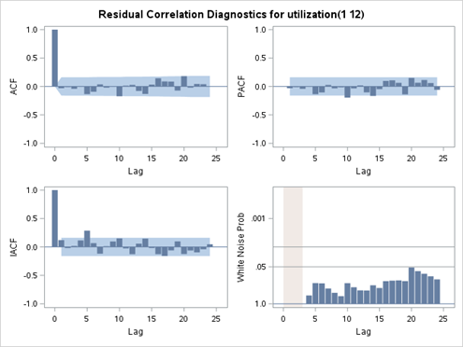
SARIMA Model Residuals Overall Utilization (2)

Slide 15
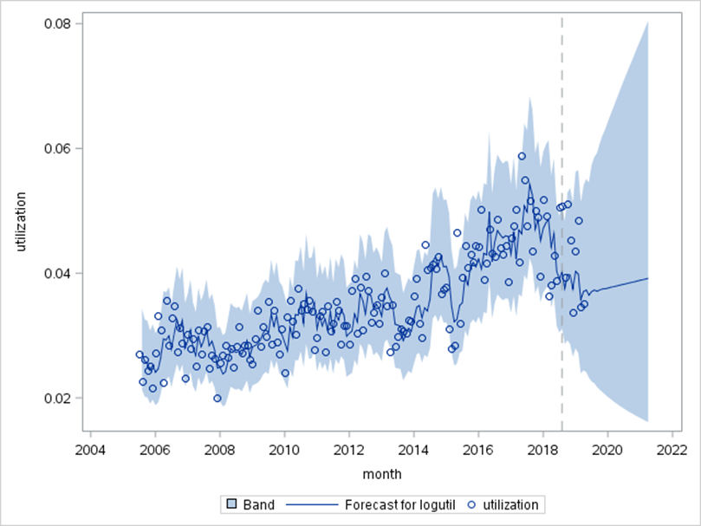
SARIMA Forecast for Overall Utilization (3)
Model: SARIMA(3,1,1)x(0,0,1)₁₂
[log transform]

Slide 16
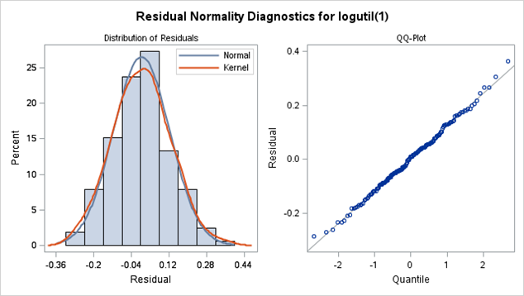
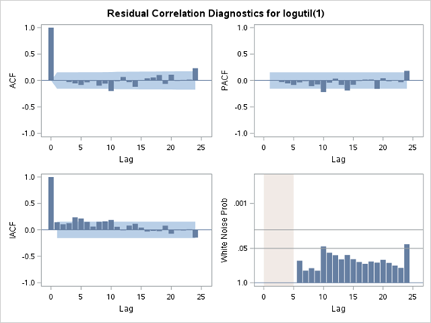
SARIMA Model Residuals Overall Utilization (3)

Slide 17
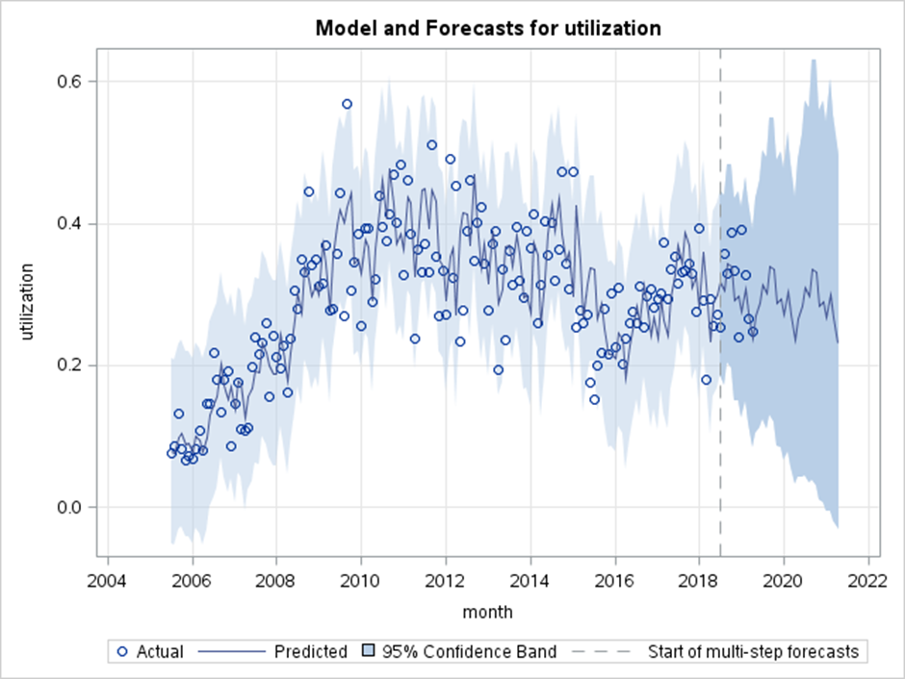
ESM Forecast for Drugs (Cult/Manu/Traf)
Model: Holt Winters

Slide 18
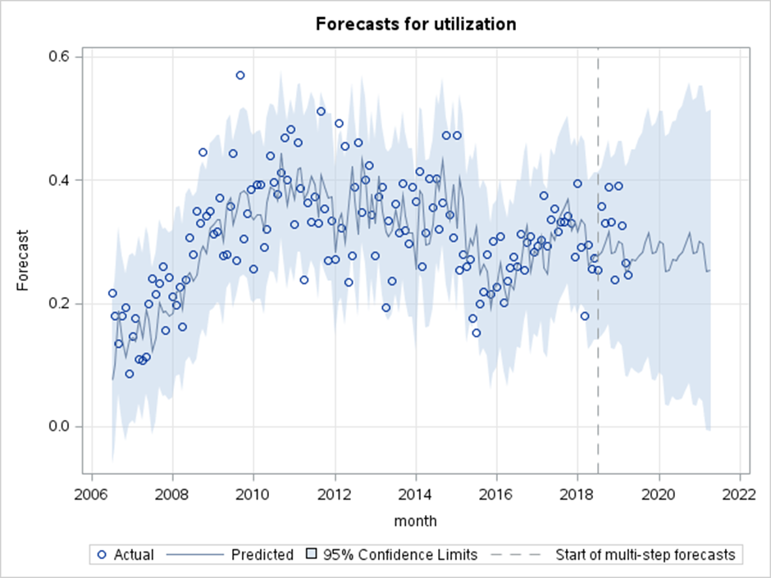
SARIMA Forecast for Drugs (Cult/Manu/Traf)
Model: SARIMA(2,0,1)x(0,1,1)₁₂
Model: Winters [log(x + 1) transform]

Slide 19
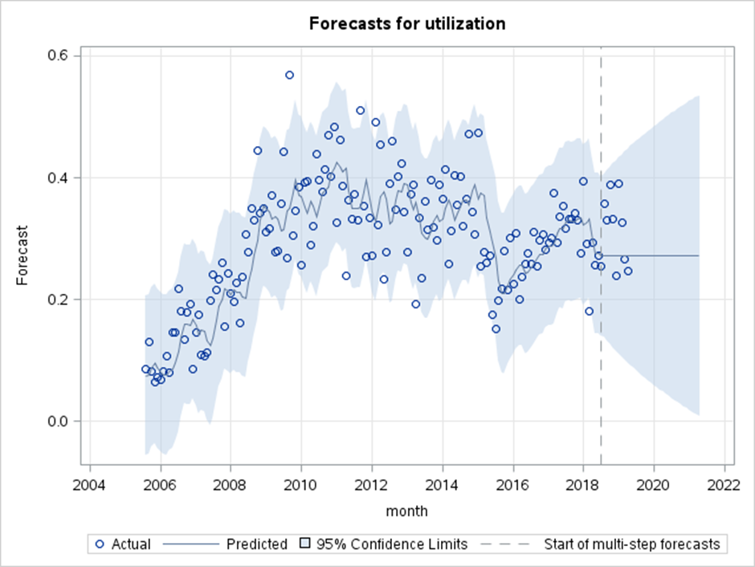
ARIMA Forecast for Drugs (Cult/Manu/Traf)
Model: ARIMA(1,1,1)

Slide 20
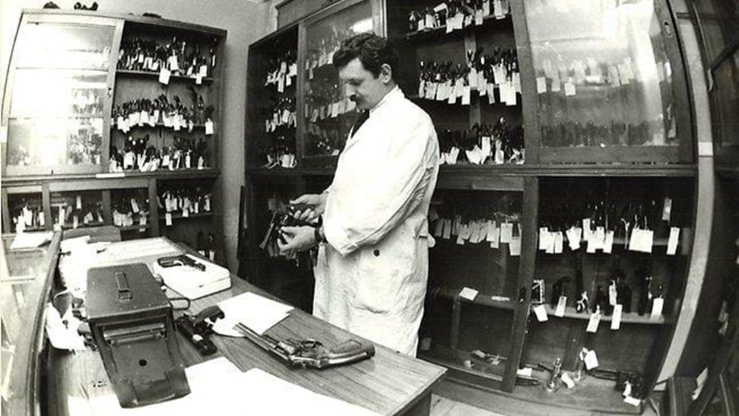
Flat Forecasts
Source: Archive News Ltd.

Slide 21
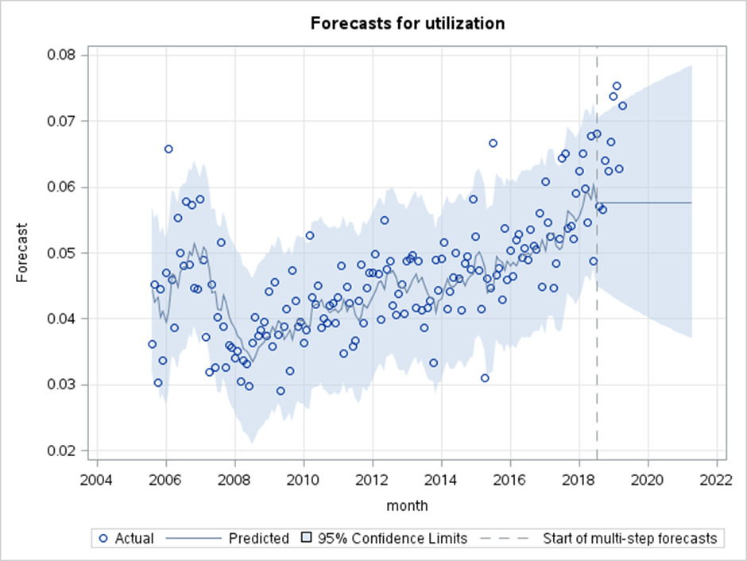
ARIMA Forecast for Burglary (Residential)
Model: ARIMA(0,1,1)
Model: Winters [log(x + 1) transform]

Slide 22
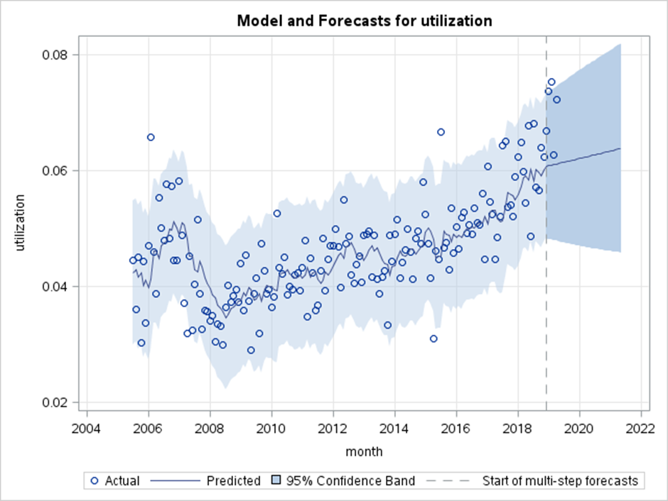
ESM Forecast for Burglary (Residential)
Model: Holt Linear
Model: Winters [log(x + 1) transform]

Slide 23
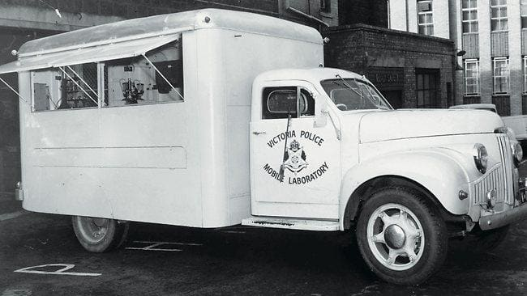
Results
Source: Victoria Police

Slide 25
Conclusions
Best data fit: 5 ESM and 5 ARIMA models
Best forecasts: 8 ARIMA models and 2 ESM models
2 ARIMA models were best data fit and best forecast
Not possible to automate the forecasting procedure
More robust validation techniques required
Other useful models: simple mean, SES, ARCH/GARCH
Images Reference:
Hatch, P. (2013, March 26). Take a look behind the scene at Victoria’s high-tech crime-fighting forensic science unit. The Herald Sun. Retrieved from http://www.heraldsun.com.au/

